Slide 1

Agentic KYC
Quick Peek
CLM
June 2nd 2026

Slide 2
A KYC agent that reads the file, runs the rules, and explains itself
Initially built end-to-end on Claude plugin.
Skills that run in sequence, plugged into CLM’s vendor-orchestration layer.
High performing, low cost, completely auditable
Built to be Angnostic
Phase 2
Still OOS
Doc Extraction
AI Insights
Rules and Screening
Authenticity
Extracts structured fields from Ids and docs in multiple language, and provides AI insights from them
AI generated recommendation and reasoning no rules or agent can fully prep for – Impossible geography, name transliteration, cross-document consistency.
Runs over Payoneer’s compliance rules and Sanction API
Local checks included in the agent (MRZ check-digits, EXIF, perceptual hashing). AI-gen detection on every doc & image
2 / 7

Slide 3
Same agent, three points in time
Each pillar maps to a different KPI and can ship independently
1
2
03
In Onboarding
Before the Rep
Quality Monitoring
Real-time decisioning
Pre manual review
Post-decision audit
Where
Where
Where
Inside CLM, In near real time
Between doc submitted & human rep queue
After the decision is final, constantly
What it does
What it does
What it does
Agent runs and returns a decision in near real time. Slots into CLM’s vendor-orchestration layer.
Agent reviews every case headed to ops and reduces manual reviews. Fully removes manual review for low value leads.
Agent re-evaluates closed. Provides decision false positive / false negative – Improving compliance and specific eBay QA commitment
Expected Impact
Expected Impact
Expected Impact
Global CVR
Reduced Tickets
Improved Rep experience Reduced Tickets.
Improved Decision Quality and Auditability
3 / 7

Slide 4

Russian user impersonating Serbian identity
How a sanctioned Russian customer bypassed KYC by registering under a different nationality
1
2
3
4
The scheme
Manual override
Vendor blind spot
The KYC agent saw
•
Russian customers registered as Serbia or Pakistan
•
Address validation flagged the mismatch
•
Re-tested 1.5 weeks ago with Resistant.AI and Persona
•
The bank statement DOES NOT prove residence in Serbia
•
Picked a non-sanctioned country at signup
•
The rep approved the Proof of Address anyway
•
Both confirmed the document as authentic and Serbian
•
50,960.00 EUR of LORO inflows in 28 days, sanctions exposure
•
Used a Russian address in the remaining fields
•
Assumption: if the document is authentic, the address must be correct
•
Authenticity checks do not enforce address accuracy
•
Recommended EDD and re-screen against OFAC, EU, UK lists
•
Sanctions screening never fired at the gate
SANCTIONS BYPASS
APPROVED DESPITE FLAG
VENDORS MISSED IT
CAUGHT BY THE AGENT
5 / 7

Slide 5
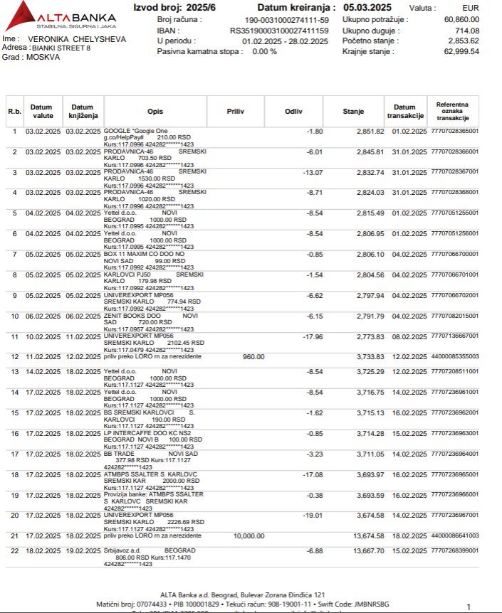
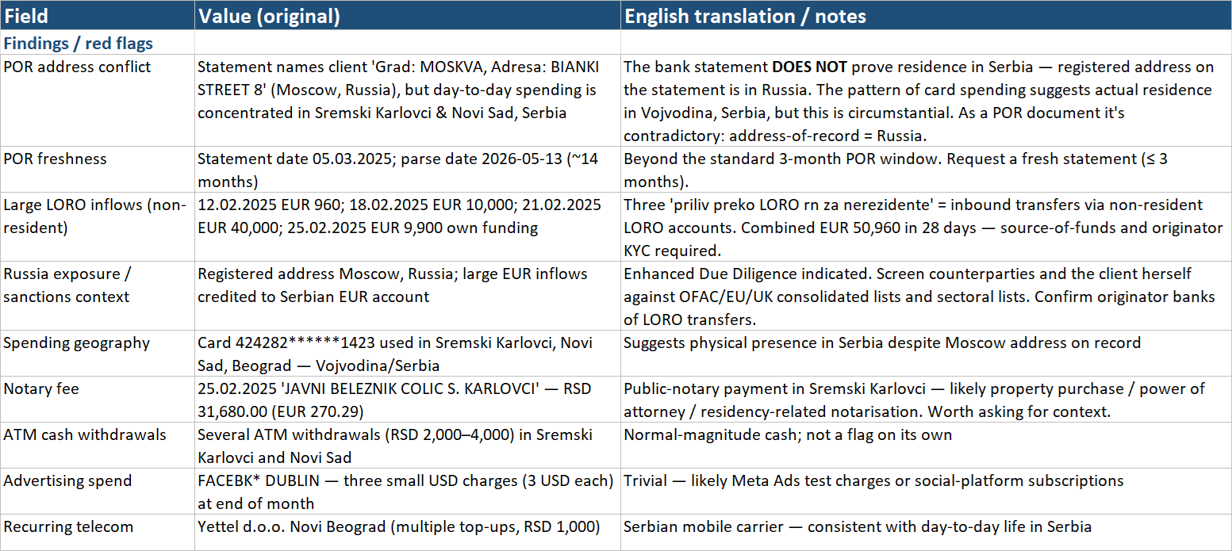
Russian user impersonating Serbian identity
The KYC agent extraction and insights
6 / 7

Slide 6
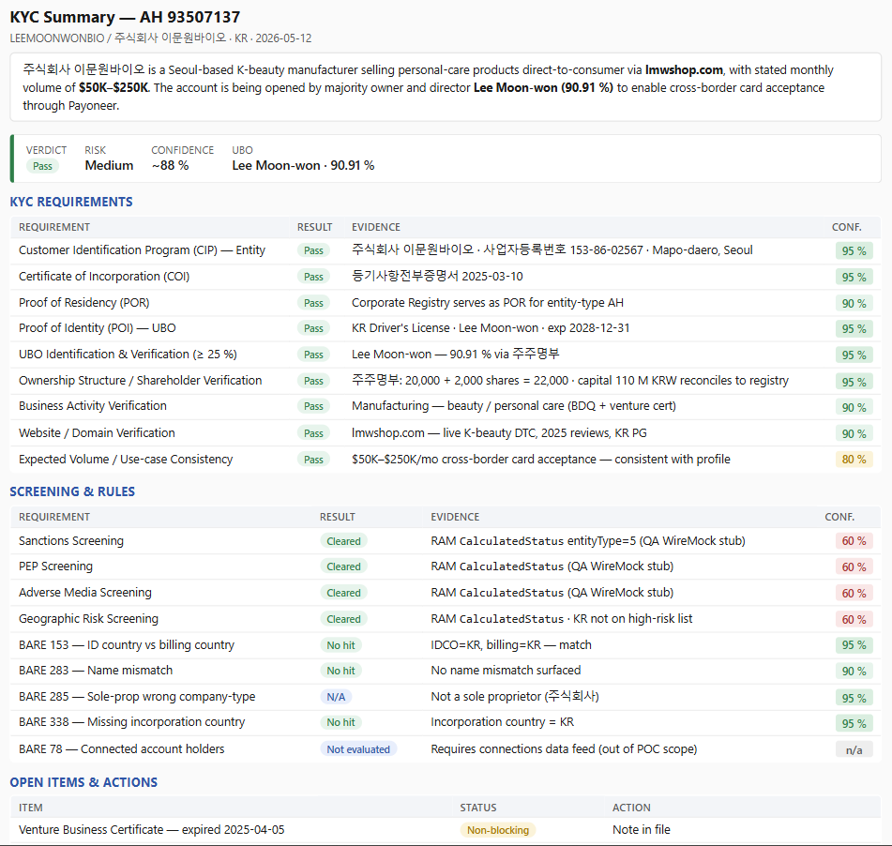
KYC SUMMARY
by the AI Agent
Soon in a Backoffice near you
4 / 6

Slide 7
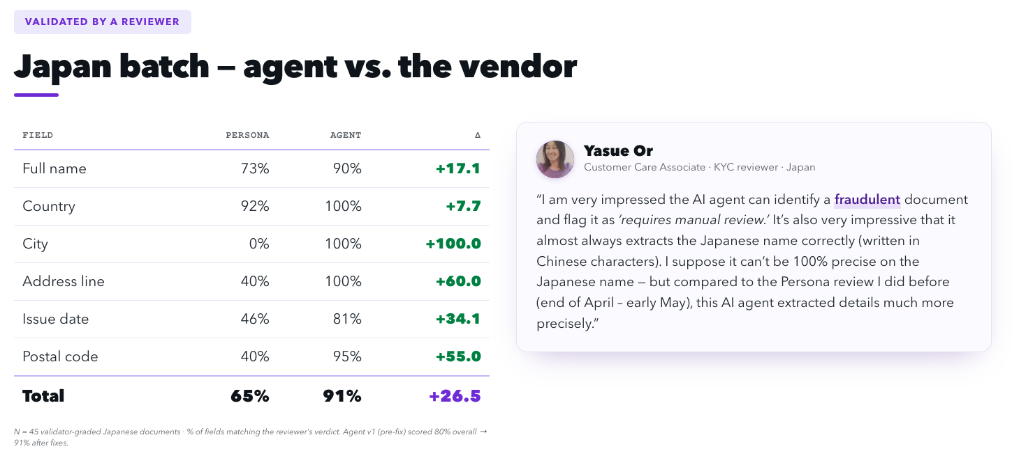

Slide 8
From PoC to production
Lower-risk deployment first, real-time onboarding last.
NOW
NEXT
AFTER
1
2
3
Testing
Non-real-time flow
Real-time flow
Build the baseline
Wire to back-office
Wire to CLM
Rep and Product test set
Pillar 2: pre-rep review
Pillar 1: in-onboarding decisioning
Accuracy and confidence calibration
Pillar 3: ongoing QA Incl. eBay data
Start with Tier 3 and 4 countries
Head to head with Auditale and KYC vendors
No user-facing latency, lower bar
Higher bar: latency, accuracy, fallbacks
7 / 7

